Slide 1
Community repair
Cooperation between consumers
Consumers vs production

Slide 2
Repair Cafe Danmark
A network of community repair groups working to
Reduce use of natural ressources
Reduce load on climate
Reduce load on environment
Reduce waste
Preserve knowledge on repairing

Slide 3
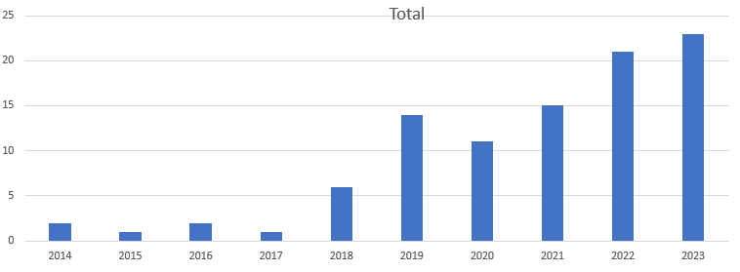
RCDK History
Yearly number of new repair cafes
As of now: A total of more than 100 repair cafes in Denmark

Slide 4
Number of repairs
A huge succes –
But we are loosing big time:
We do repairs totaling 0.1 pct
of the total amount of danish
Electronic waste

Slide 5
Landsdækkende (næsten)

Slide 6
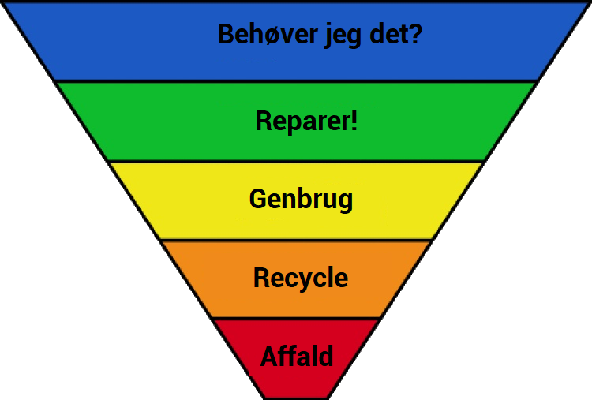
Waste reduction battle
It doesn’t start with a screwdriver or a hammer – it starts in the mind of people.

Slide 7
Production without limitations
Production requires profit and with no regulation the methods are endless:
Planned obsolesence
Repair obstacles

Slide 8
Planned obsolesence
Productdeterioration (filament lamps, nylon)
Built-in end of life (inkjet printers)
Designpriorities (sloppy lifetime considerations)
End of life from relations (MitID – new phone)
The sawtooth curve of quality
Fashion
You own samples?

Slide 9
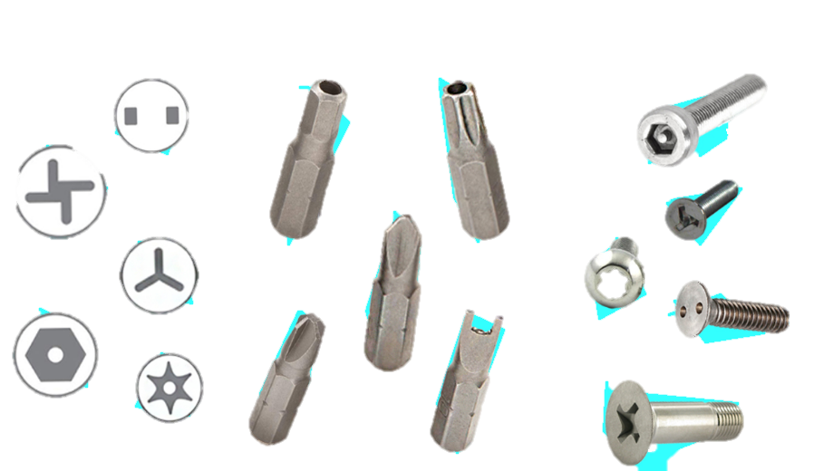
Repairability obstructions
Glued joints
Breaking Plastic plugs
Special screws
Parts pairing

Slide 10
Consumers unite
Data, data, data, data
Information to consumers
Request to legislators

Slide 11
The tricky part
Our energy comes from the social cooperation in community groups
It works – for most members - on the general understanding that ”this is important”
Generalized data collection and data science has less space when the sewing and soldering is the fun part.
Reaching legislators is realy uphill
Expansion ”bu popular request” is very difficult working with volunteers

Slide 12
Volunteer Motivational factors
The good cause
It makes a difference
Using and maintaining your skillset
Community / Teamwork
Significance
Fun/interest
Conscience

Slide 13
Pitfalls
DON’T:
Enforce
Require
Expect
Divide
Reward (what?!?)
DO:
Listen
Be democratic
Be Patient
Communicate
Encourage

Slide 14
More
www.repaircafedanmark.dk
kontakt@repaircafedanmark.dk
facebook.com/RepairCafeDanmark
Repair Cafe Danmark is supported by LB Foreningen

Slide 15
Questions?
? ? ? ? ? ? ? ? ? ?

Slide 16
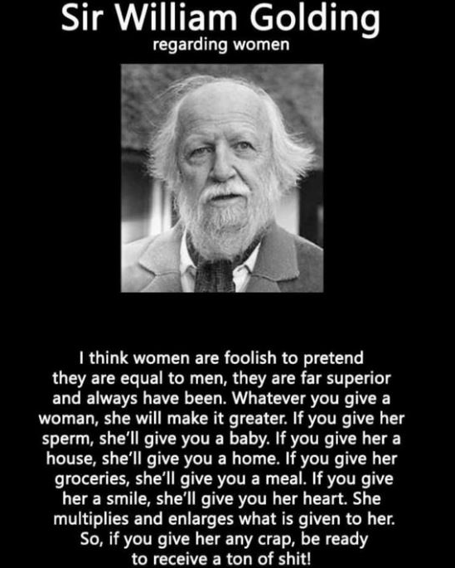
March, 8th
International Womens Day was proposed by Clara Zetkin on the Socialistic Second International Conference in Copenhagen in 1910.
Consumer rights is close connected to female organisations – the danish Forbrugerrådet was founded in 1947 as Danske Husmødres Forbrugerråd

